Slide 1
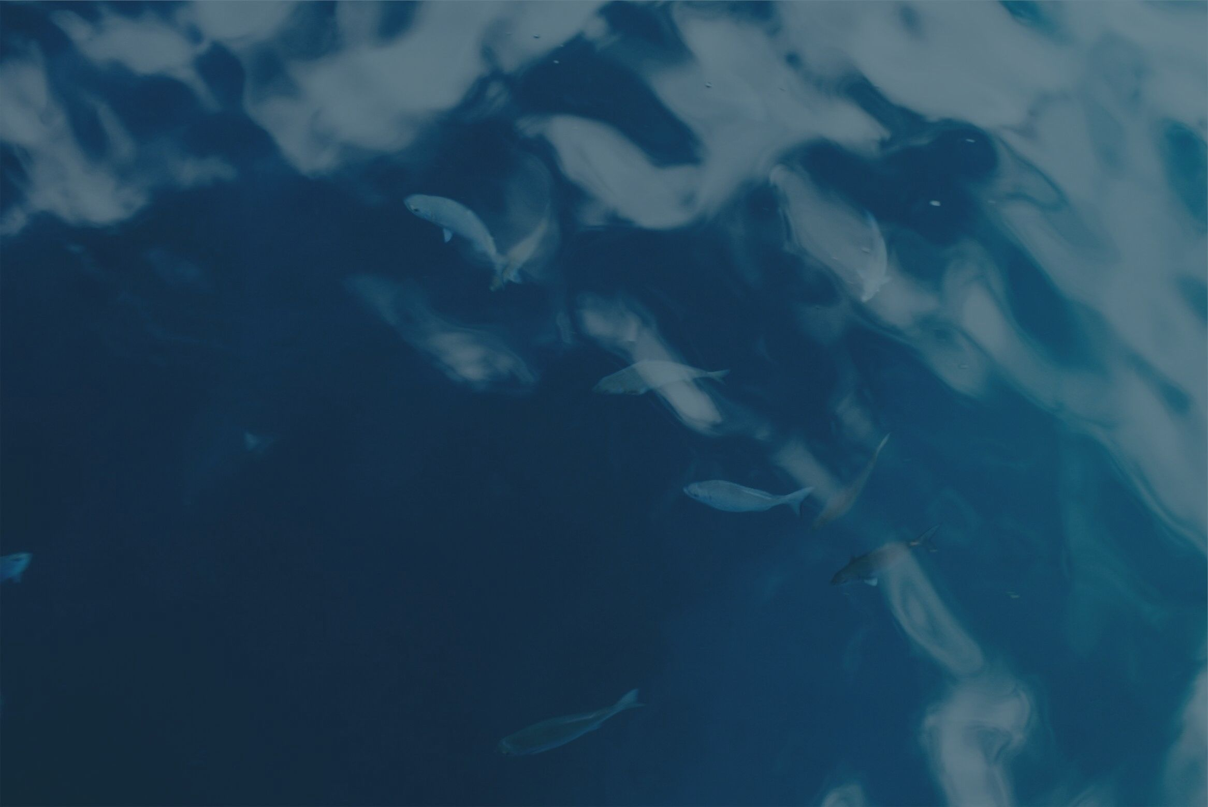

HACKATHON FOR GOOD - 2019
HELPING OTHERS STARTS WITH YOU
Team #13 - RED-X

Slide 2
Our team and this serendipitous encounter
Our effective team captain: Jimmy
Our amazing designer; Madhu
Our magical techies: Jay & Abbas
Our creative cheerleader: Alvin
Organically formed & willing and able to see this through

Slide 3
The process
— We wanted something that everybody can do & with minimum (measuring) equipments
— Works offline and with GPS
— Is more effective than manual data gathering
— Language independent

Slide 4
Our solution:
- We let volunteers take pictures instead of doing manual data entry
- We use AR (augmented reality) to asses flood extent mapping & flood damages

Slide 5
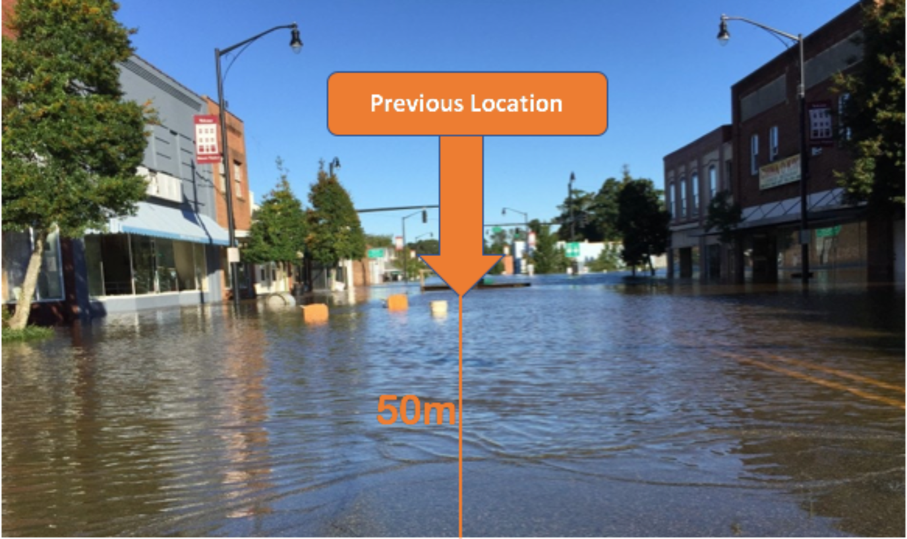
Why Augmented Reality?

Slide 6
DEMO TIME!!

